Slide 1

Englisher
An assistive English Learning app for rural teachers and students
Download on Google Play
www.englisherapp.com
Notes:
1

Slide 2
2
App Review from Teachers
Need listening, reading, writing, speaking modules
App needs to follow NCTB Syllabus thoroughly
Need offline support
English Grammar Support
Need web version of the application
Video tutorials can be helpful
Make the app more vocabulary friendly
The app needs to give a lot of practice materials for the students
www.englisherapp.com

Slide 3
3
Cost of Budget
Cost of Budget
Details | Unit/Month | Amount | Total
Project Manager Salary | 3 | 30000 | 90000
RA Salary | 3 | 20000 | 60000
Survey | 1 | 40000 | 40000
Crest Design Cost | 55 | 300 | 16500
App Making | 1 | 90000 | 90000
Domain Hosting | 1 | 3500 | 3500
 |  | Total | 300000
www.englisherapp.com

Slide 4
4
Field Survey Observation
Smaller city school administration are more co-operative than Dhaka city
Rural school teachers appreciated the approach more
Female teachers were more clear while answering the questions
Without official document it was had to do the survey in Dhaka city
The Teachers of outside Dhaka city were more cooperative in giving information
The Dhaka city school administration did not give permission for video footage
www.englisherapp.com

Slide 5
5
App Screenshots
www.englisherapp.com

Slide 6
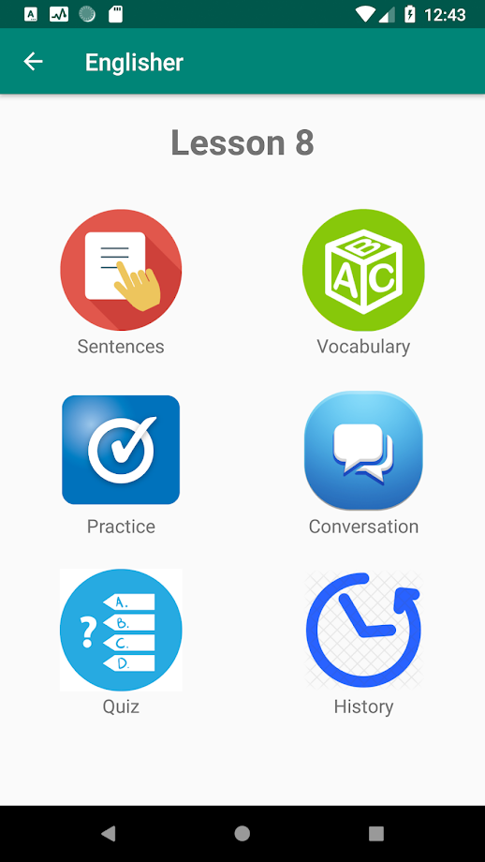
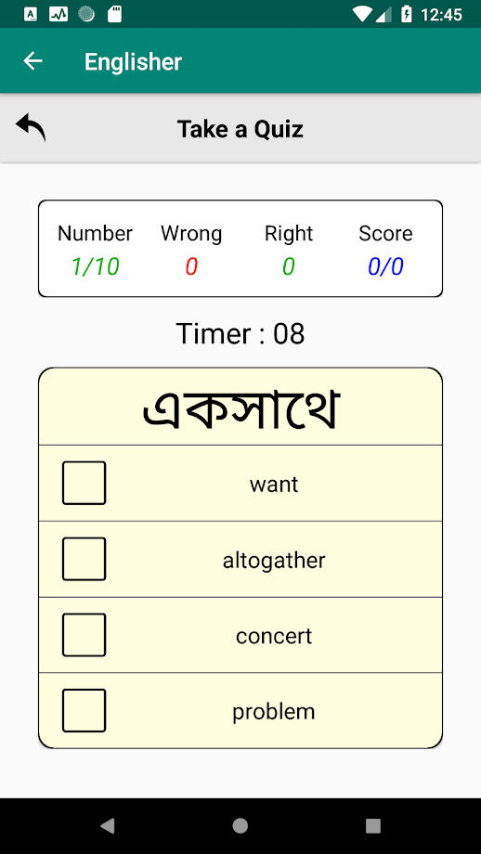
6
www.englisherapp.com

Slide 7
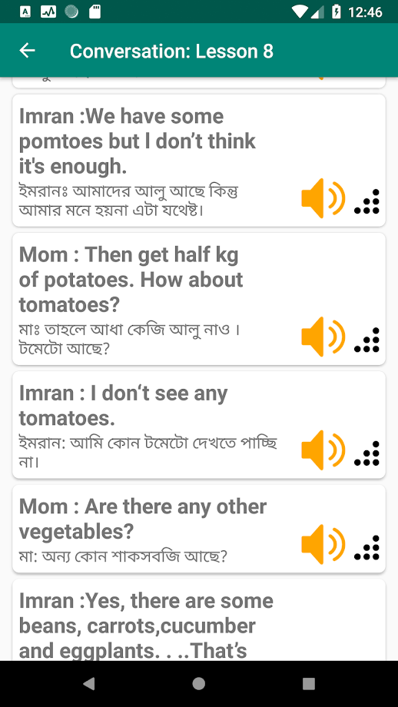
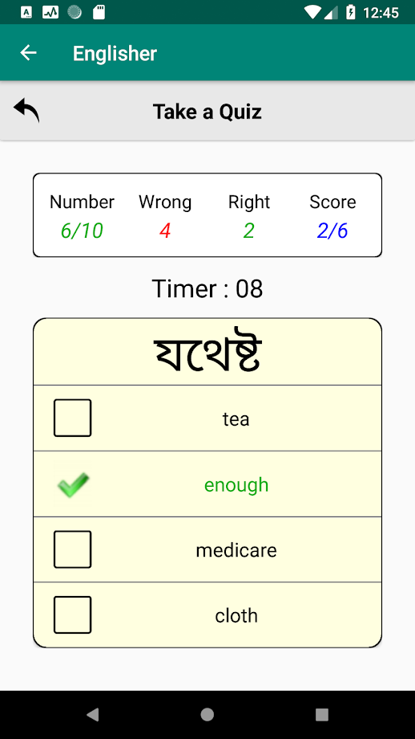
7
www.englisherapp.com

Slide 8
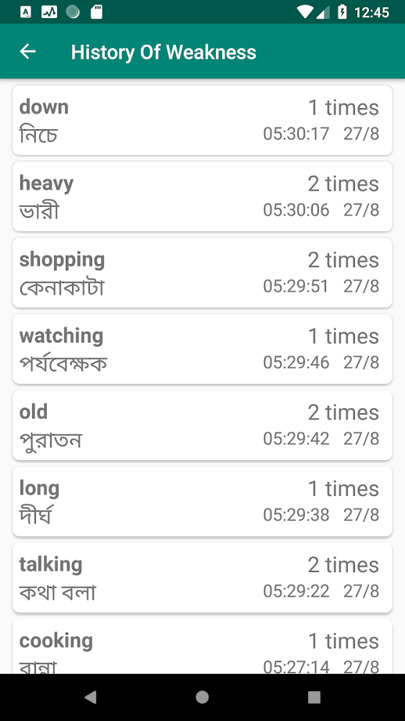
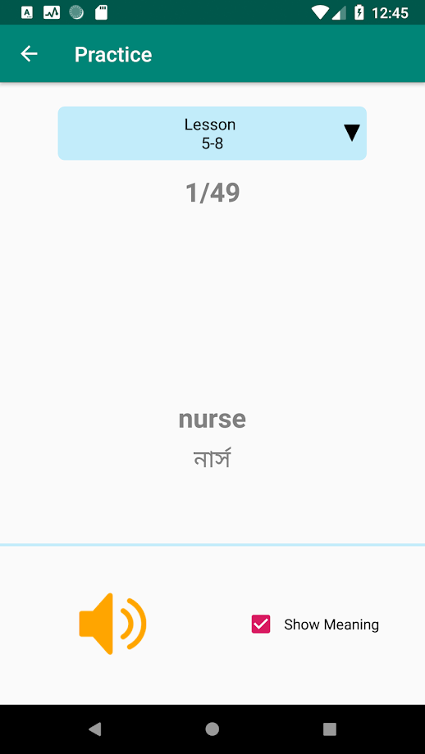
8
www.englisherapp.com

Slide 9
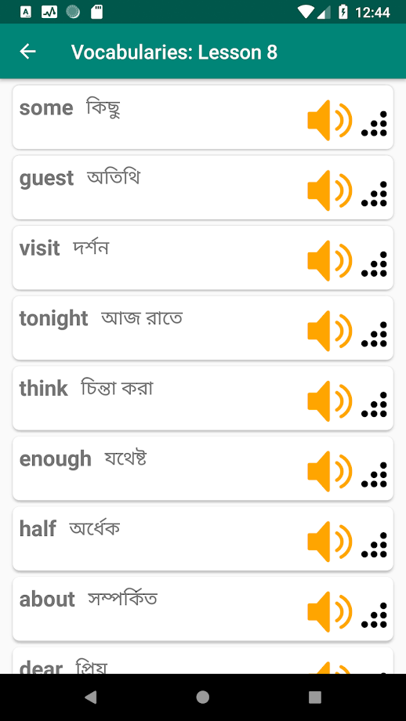
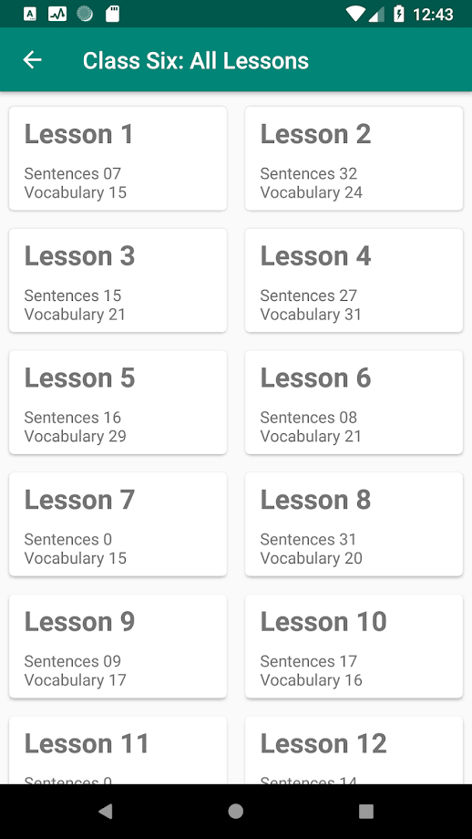
9
www.englisherapp.com

Slide 10
10
Budget Plan for Two Lac
Budget Plan for 2 Lac
Details | Unit/Month | Amount | Total
App Modification | 1 | 60000 | 60000
Survey | 1 | 40000 | 40000
RA Salary | 2 | 20000 | 40000
Project Manager | 2 | 30000 | 60000
 |  | Total | 200000
www.englisherapp.com

Slide 11
11
After Survey Total Budget Plan
Activity Expenditure | Unit Cost | Unit/Months | Total
Project Manager | 15000 | 24 | 360000
Senior Mobile App Developer | 60000 | 10 | 600000
Junior Software Engineer | 25000 | 12 | 300000
Graphic Designer(UI/UX) for Android | 25000 | 3 | 75000
Research Assistant(RA) | 25000 | 24 | 600000
Miscellaneous(printing, copy, banner etc.) | 200 | 100 | 20000
Online Advertising & Fee | 50000 | 1 | 50000
Grand Total |  |  | 2005000
www.englisherapp.com

Slide 12
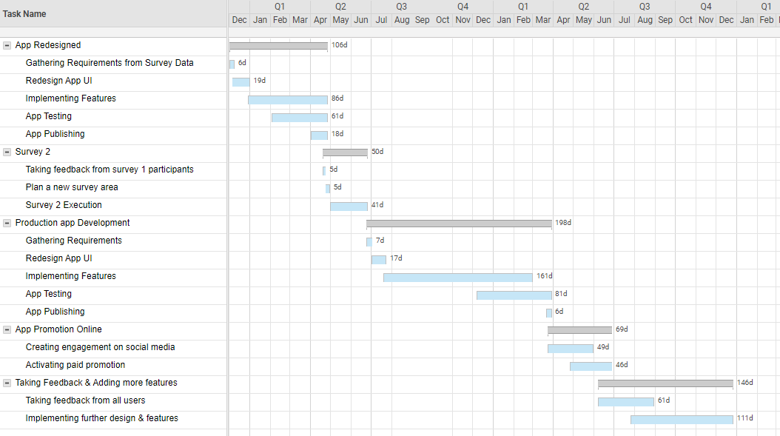
www.englisherapp.com
Full Project Plan-v1
Today
0%
3 Nov - 3 Dec
0%
4 Dec - 4 Jan
0%
5 Jan - 5 Oct
0%
6 Oct - 3 Jan
0%
6 Oct - 3 Jan
0%
6 Oct - 3 Jan
0%
6 Oct - 3 Jan
0%
6 Oct - 3 Jan

Slide 13
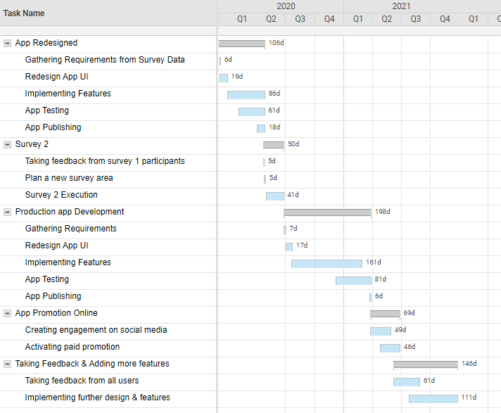
www.englisherapp.com
Full Project Plan-v2
Today
0%
3 Nov - 3 Dec
0%
4 Dec - 4 Jan
0%
5 Jan - 5 Oct
0%
6 Oct - 3 Jan
0%
6 Oct - 3 Jan
0%
6 Oct - 3 Jan
0%
6 Oct - 3 Jan
0%
6 Oct - 3 Jan

Slide 14
14
Thank you
www.englisherapp.com

